Slide 1
Improving Language Understanding with Contextualized, Visual-Grounded Supervision
Hao Tan Mohit Bansal
EMNLP 2020
Notes:
Hello everyone. The topic of my talk today will be about enhancing machine natural language understanding by incorporating visual-grounded supervision in the pretraining phase. The gist of my talk will be exemplified by the paper called “improving language understanding with contextualized, visual-grounded supervision”.

Slide 2
Table of Content
Motivation
Visually-Supervised Language Modeling
Creating Visual Supervision
Experiments
Discussion
Notes:
First, I will talk about why do we need visual-grounded supervision to improve machine natural language understanding. Then I will introduce the task of visually-supervised language modeling, as well as a prior solution on how can we acquire such dense visual supervision signal in practice. Following is the experiment and discussion.

Slide 3
Table of Content
Motivation
Visually-Supervised Language Modeling
Creating Visual Supervision
Experiments
Discussion

Slide 4
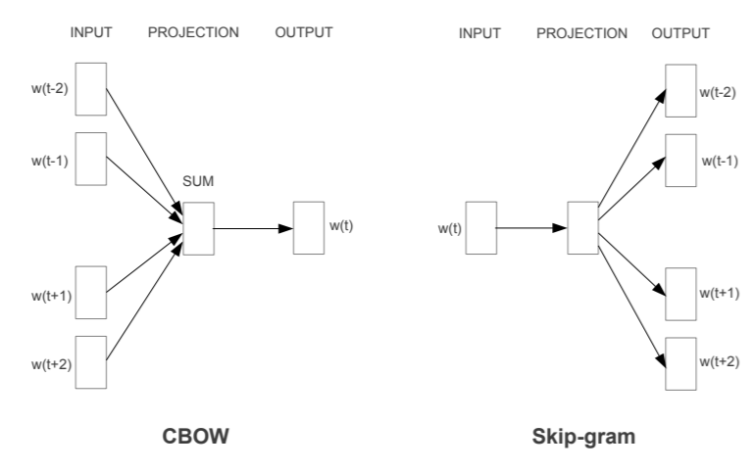
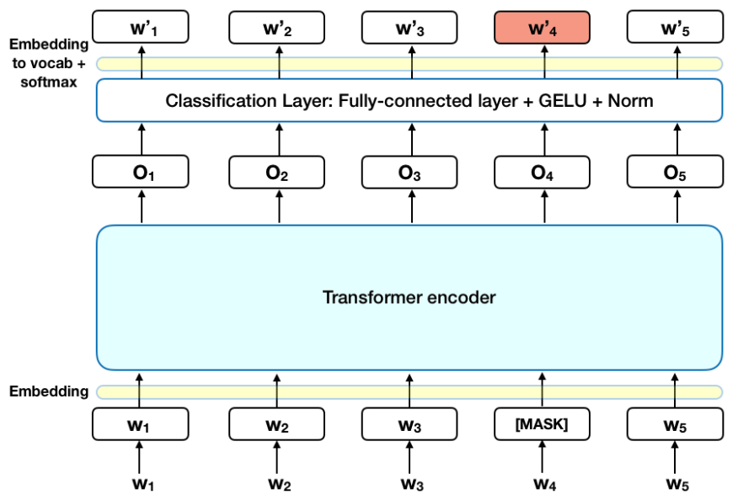
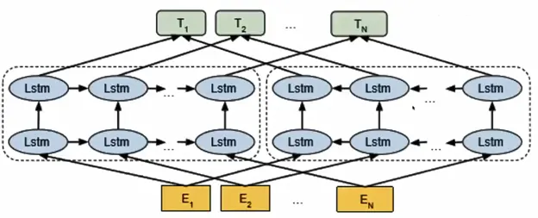
Distributional Semantics
Much of the empirical success in NLP history can be attributed to the advances of models based on distributional hypothesis.
distributional hypothesis: the contexts in which an expression appears give us information about its meaning.
Word2Vec (2013)
ELMo (2018)
BERT (2019)
Quiz: what is the major difference between Word2Vec and ELMo/BERT?
Notes:
So, in retrospect, much of the empirical …
The earliest and most seminal distributional semantic model is the Word2Vec model. It has two variants: CBOW and Skip-Gram. Taking CBOW as an example, each word is assigned with a static embedding vector which is optimized to be most predicative of the centric word. The trained word vectors have facilitated various applications, including semantic retrieval. In 2018, the situation was changed. The ELMo model propose to represent each word with dynamic embedding vector by considering both left and right context. The pretraining objective of ELMo is to predict a word given its left context or right context. Similar idea was also adopted in BERT, but BERT use a more sophisticated Transformer architecture, instead of a bi-directional LSTM model. The main pretraining objective of BERT is to recover the masked token id given its bi-directional context.
Here is a quiz:
Answer: after training, the embedding is static or dynamic when applied in downstream tasks.

Slide 5
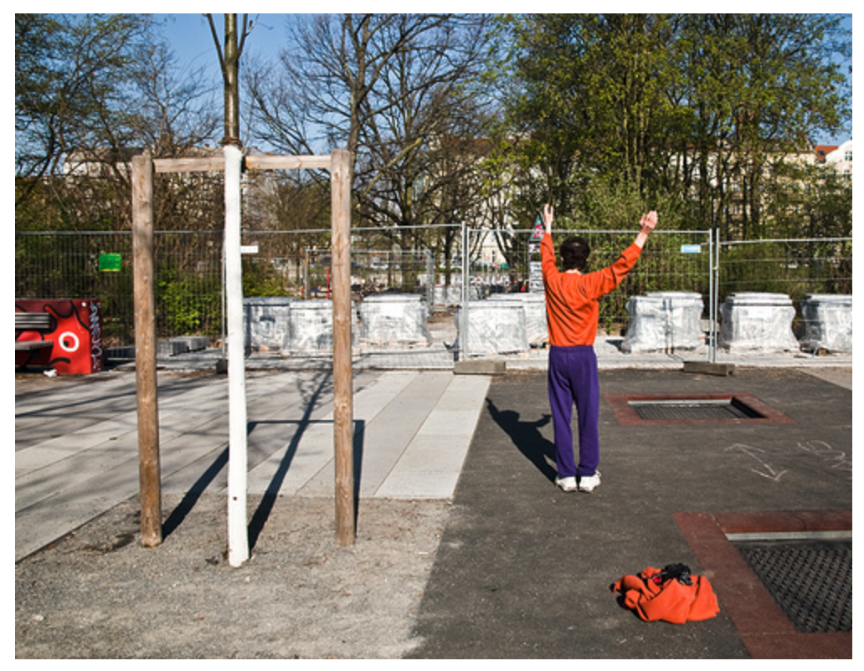
Grounding
However, purely distributional semantic models are not grounded, as they are only trained to memorize the co-occurrence pattern of “token id”, with no connection to external world.
grounding: the capability of relating language to the world, including sensory perception, motor control and social activity.
A man dressed in orange and purple stands with his hands above his head at a park.
Notes:
However, all three distributional semantic models mentioned before are not grounded, as they are trained only on text, with no explicit connection to the external physical world.
Grounding refers to the capability of relating language to the world, including sensory perception, motor control and social activity.
For example, given the sentence: a man dressed in orange and purple stands with his hands above his head at a park. We can easily recall a real scene or picture a virtual scene in our minds that corresponds to the sentence. Grounding is an inherent ability of human beings, but is largely missing in existing NLP models.

Slide 6
Table of Content
Motivation
Visually-Supervised Language Modeling
Creating Visual Supervision
Experiments
Discussion
Notes:
Next, I will introduce the pretraining task of visually-supervised language modeling.

Slide 7
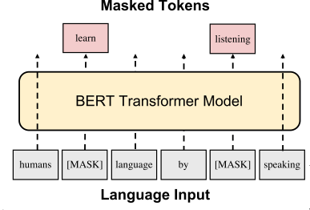
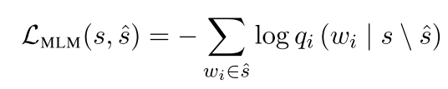
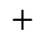
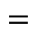

Masked Language Modeling
Retrospection on conventional masked language modeling.
Objective: predict the masked token using the contextual representation of [MASK] token , conditioned on unmasked tokens.
learn｛
output embedding matrix
$$=$$
$$̇$$
$$+$$
[MASK]
logits
Bias
Notes:
Before stepping into the visually-supervised language modeling, let’s first do a retrospection on the conventional masked language modeling, which is pervasive in current language representation learning literatures.
The input to the model is a sentence with certain tokens being replaced with the special [MASK] token.
The objective of MLM is to predict the masked token using their contextual representation from the last layer, conditioned on all the unmasked tokens.
The final contextual representation of [MASK] token is formed by repeatedly aggregating information from the context.

Slide 8
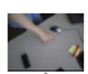
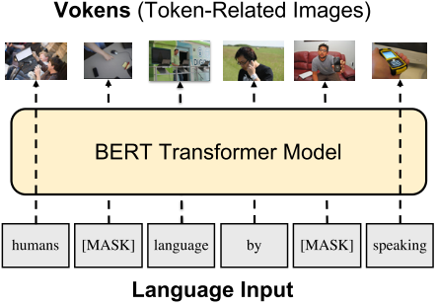
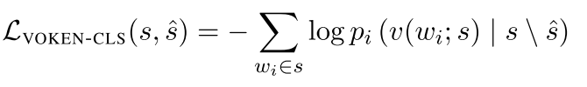

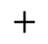
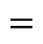
Visually-Supervised Language Modeling
Introducing visually-supervised language modeling.
Assume that each token is related with an image describing its real-world manifestation.
The image associated with each token is called “voken”, short for “visualized token”.
Objective: predict the voken using contextual representation of [MASK], conditioned on unmasked tokens.
｛
output embedding matrix
$$=$$
$$̇$$
$$+$$
[MASK]
logits
Bias
Notes:
Through the lens of masked language modeling, the language model is now effective at capturing co-occurrence pattern of language symbol. However, as stated before, this kind of pure distributional semantic model is not grounded.
Now let’s assume that there exists a corpus, and each token in the corpus is related with an image describing its real-world manifestation. The image associated with each token is called ”voken”, short for “visualized token”.
The input to the model is still a sentence with certain tokens being replaced with [MASK].
The objective is to predict the voken corresponding to the original token using the contextual representation of [MASK] from the last layer, conditioned on unmasked tokens.

Slide 9
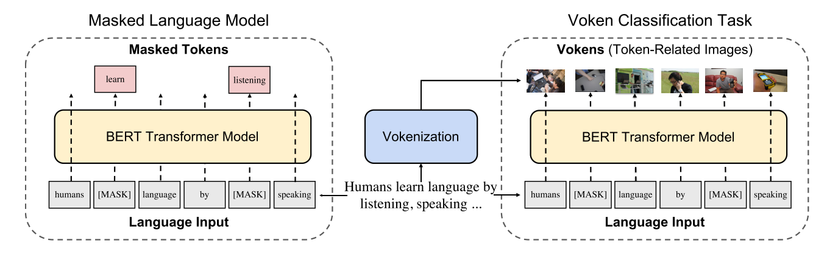
Visually-Supervised Language Modeling
Put them together as multi-task learning.
Notes:
By putting the two tasks together as multi-task learning, we finally arrive at the visually-supervised language modeling.
The training objective is weighted sum of the two sub-objectives.

Slide 10
Table of Content
Motivation
Visually-Supervised Language Modeling
Creating Visual Supervision
Experiments
Discussion
Notes:
Now let’s move on to creating visual supervision part.

Slide 11
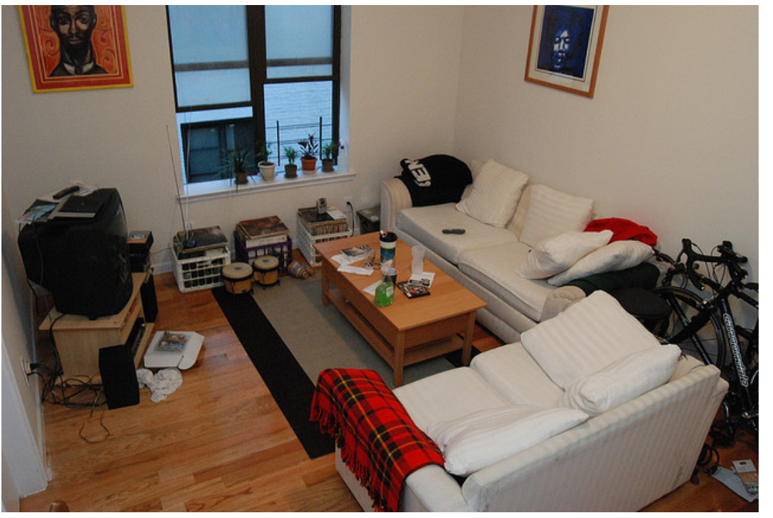
Creating Visual Supervision
Quiz: how to acquire such a corpus in which each token has its visual supervision?
The most straightforward choice is image captioning resources.
a somewhat cluttered living room area with white couches and a small tv.
a living room filled with furniture and a window.
a small living room has a tv and furniture.
a living room with a couch a table and tv.
a room with two couches and a television.
Voken
A pair of image and captions from MS COCO dataset.
Notes:
And here is quiz: how to acquire such a corpus in which each token has its visual supervision?
Here is an exampling showing a pair of image and captions from MS COCO dataset. The goal of an image caption is to depict the visual content present in the image using natural language. Therefore, the image naturally becomes the visual supervision for all tokens in the caption.
This is a good news. It seems that we can leverage such image captions directly as the pretraining corpus for visually-supervised language modeling.

Slide 12
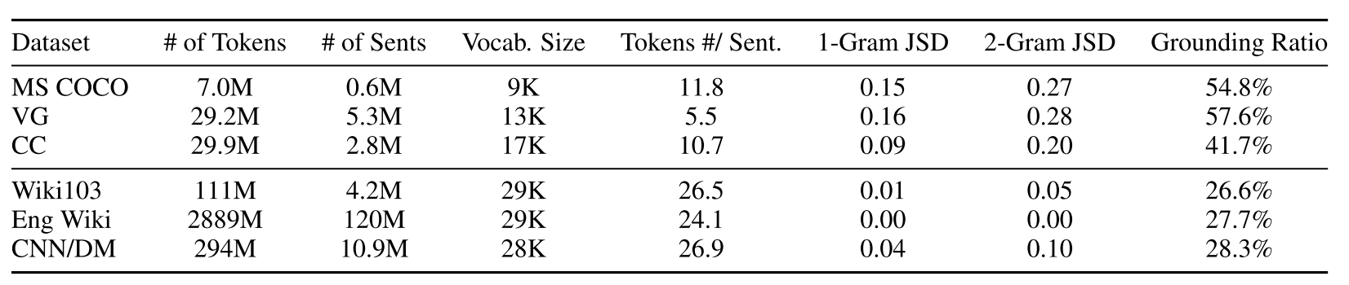
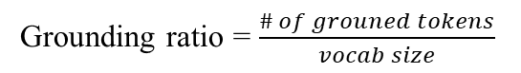
Creating Visual Supervision
However, image captioning datasets are not suitable as the main resources for training.
Image caption belongs to grounded language, exhibiting a large statistical discrepancy to other types of language in general domain:
｛
Image captioning datasets
｛
Corpora commonly used for
pretraining
Grounding ratio = $\frac{\# of grouned tokens}{vocab size}$
🤔
How can we take advantage of such alignment signal in image caption datasets and apply it to general-domain corpora?
😎
Use it as weak supervision to train a voken retrieval model!
Notes:
Unfortunately, existing image captioning datasets might not be suitable as the pretraining corpus.
The reason behind is that image caption belongs to a special type of language, dubbed grounded language. It exhibits a large statistical discrepancy to other types of natural language in the general domain.
This table shows some key statistics of 3 image captioning datasets and 3 general-domain corpora.
As can be seen from the table, the vocabulary size of image captioning datasets is almost half of general-domain corpora. And the average sentence length is also much shorter than that of general-domain corpora.
Another notable metric is the grounding ratio, which is defined as the proportion of grounded tokens in the vocabulary. A token is deemed grounded if it appears more than 100 times in the MS COCO datasets.
Given the observed discrepancy, the next question is that ”how can we …”

Slide 13

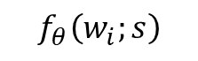
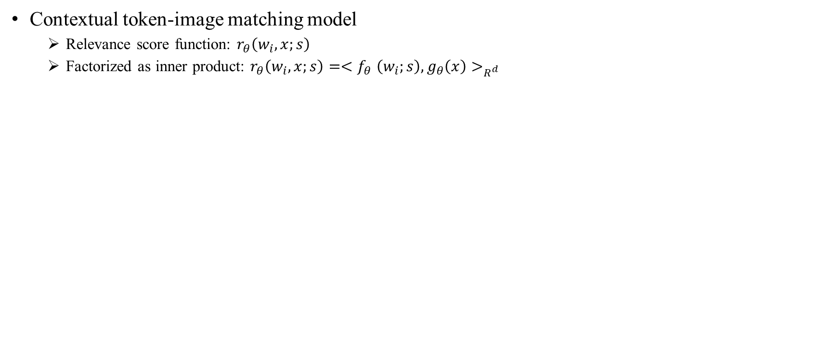
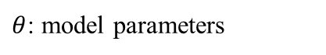
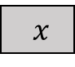
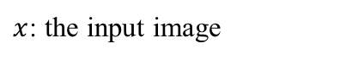

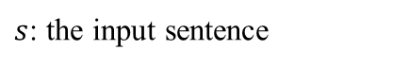
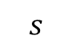
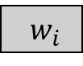
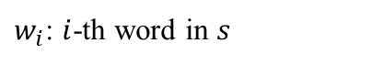
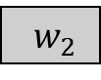

Creating Visual Supervision
Contextual token-image matching model
Relevance score function: $r_{θ}\left(w_{i},x;s\right)$
Factorized as inner product: $r_{θ}\left(w_{i},x;s\right)={<f}_{θ}\left(w_{i};s\right), g_{θ}\left(x\right)>_{R^{d}}$
$$f_{θ}\left(w_{i};s\right)$$
$$g_{θ}\left(x\right)$$
L2-normalization
L2-normalization
Notations:
MLP
MLP
$s$: the input sentence
$w_{i}$: $i$-th word in $s$
BERT
ResNeXt
$x$: the input image
$θ$: model parameters
: fixed
: trainable
$w_{1}$
$w_{2}$
· · ·
$w_{i}$
· · ·
$w_{l}$
$x$
$$s$$
Notes:
In order to train a voken retrieval model, we first need a way to quantify the relevance between an image and a token. And here comes the contextual token-image matching model, which measures the relevance score between an image and a token in a sentence.
The relevance score function “…”

Slide 14
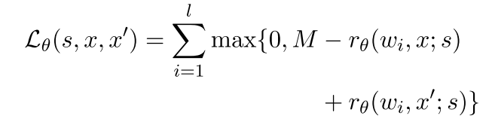
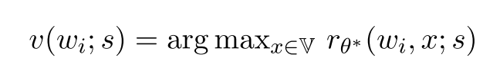
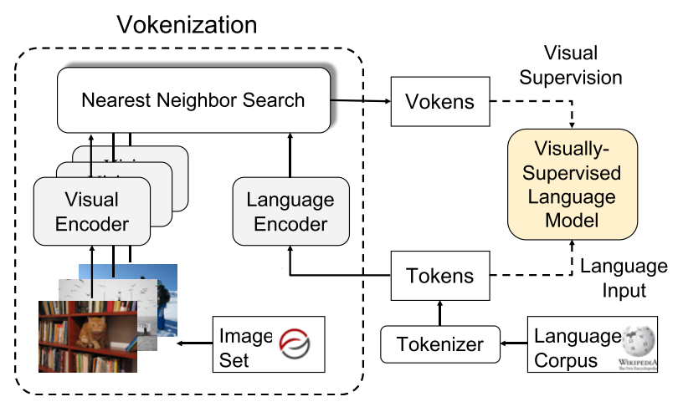
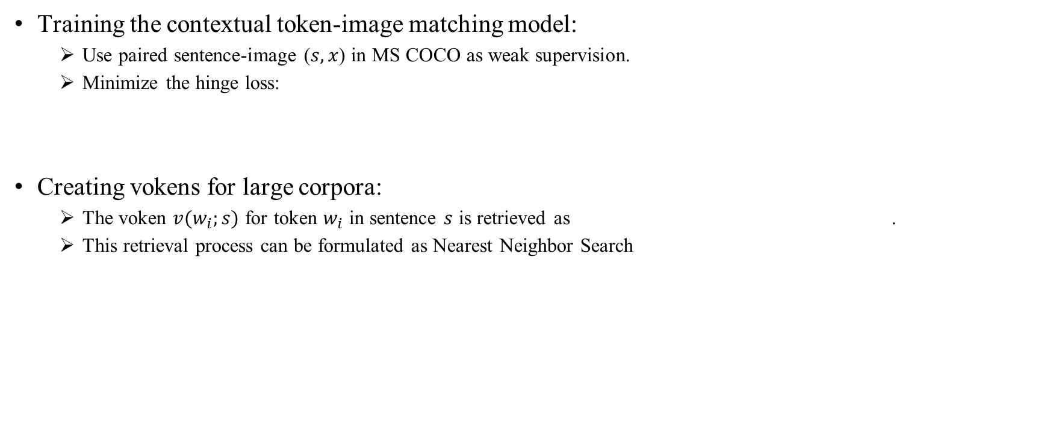

Creating Visual Supervision
Training the contextual token-image matching model:
Use paired sentence-image ($s, x$) in MS COCO as weak supervision.
Minimize the hinge loss:
Creating vokens for large corpora:
The voken $v(w_{i};s)$ for token $w_{i}$ in sentence $s$ is retrieved as .
This retrieval process can be formulated as Nearest Neighbor Search
Quiz: what is $x^{′}$ ?
Another randomly sampled image, serving as negative sample.
Images from Visual Genome

Slide 15
Table of Content
Motivation
Visually-Supervised Language Modeling
Creating Visual Supervision
Experiments
Discussion

Slide 16
Experimental Setup
Pretraining corpora
English Wikipedia
Wiki103
Language models(train from scratch)
6-layer BERT
12-layer BERT
6-layer RoBERTa
12-layer RoBERTa
Fine-tuning tasks
Subset of GLUE: SST-2, QNLI, QQP, MNLI
SQuAD v1.1, SQuAD v2.0
SWAG

Slide 17
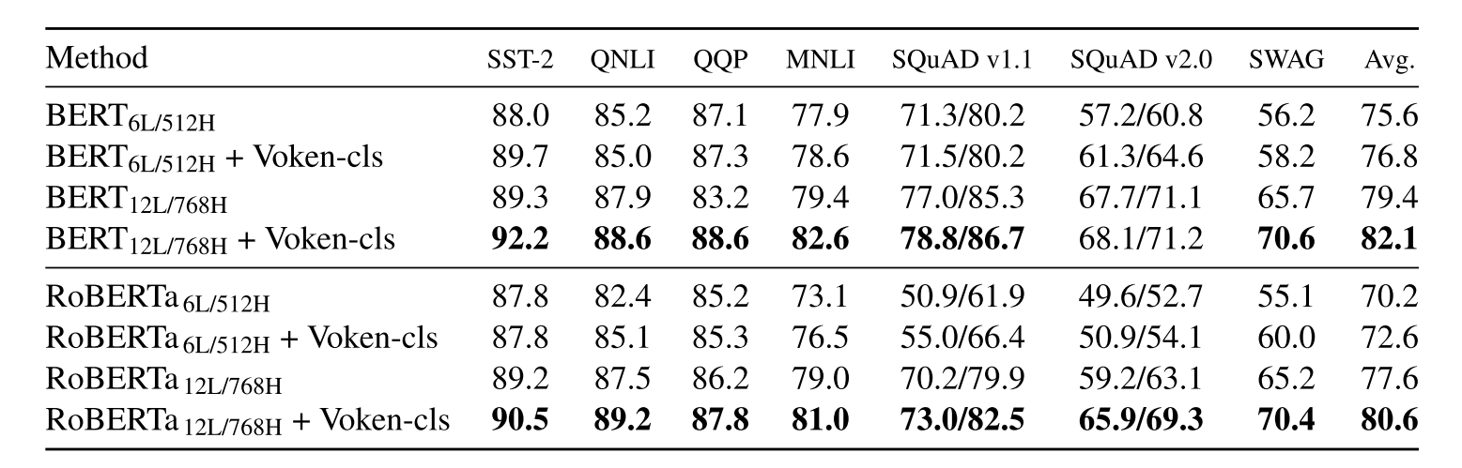
Experimental Results
Fine-tuning results on downstream tasks
Observations:
The fine-tuned BERT outperforms RoBERTa in author’s reimplementation.
Visual supervision provides consistent improvements over MLM-only on all tasks, particularly on SWAG, where grounded commonsense inference is required.
Notes:
This table shows the full fine-tuning results of bert and roberta on all the tasks.
From this table we can make several observations:
1. The fine-tuned BERT outperforms RoBERTa in author’s reimplementation。 This is because
2.

Slide 18
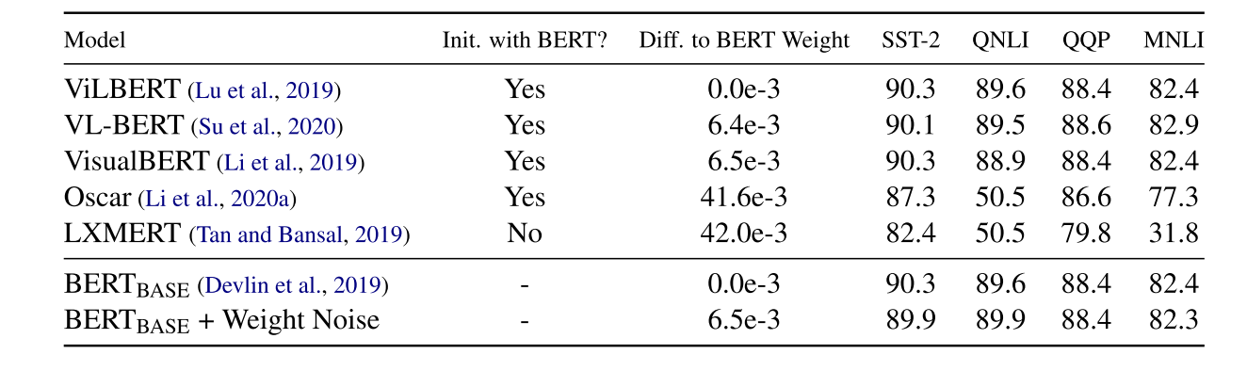
Experimental Results
｛
Vision-Language pretraining(VLP) models
Observations:
VLP models based on visually grounded dataset may not effectively generalize to pure-language tasks.
VLP models initialized with BERT weights generally performs better.

Slide 19
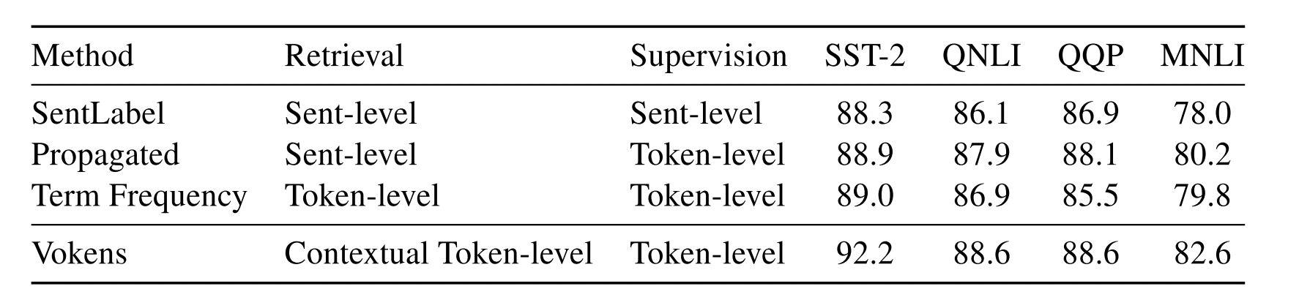
Experimental Results
Ablation study on visual supervision
Observations:
Token-level supervision > sentence-level supervision.
Token-level retrieval > sentence-level retrieval.
Contextual matching > frequency-based statistics.
Notes:
This table shows the results of different schemes of utilizing visual supervision.
Sent-level retrieval means that we are now using a sentence-level voken retrieval model, and each sentence is assigned with one image.
Sent-level supervision means that the voken classification task is performed one time for the whole sentence.
Token-level supervision means that the image is propagated to all the tokens in the sentence, and voken classification is performed for all tokens in the sentence.

Slide 20
Experimental Results
Ablation study on visual supervision
Observations:
Token-level supervision > sentence-level supervision.
Token-level retrieval > sentence-level retrieval.
Contextual matching > frequency-based statistics.

Slide 21
Experimental Results
Ablation study on visual supervision
Observations:
Token-level supervision > sentence-level supervision.
Token-level retrieval > sentence-level retrieval.
Contextual matching > frequency-based statistics.

Slide 22
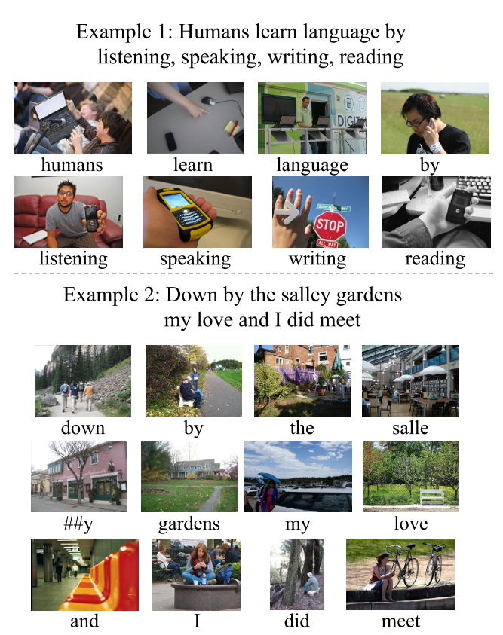
Visualization
Notations:
: reasonably matched
: mismatched
Observations:
The vokenizer shows strong selectivity as different images are retrieved w.r.t different tokens.
Concrete nouns(e.g., salle, gardens) are easier to ground in comparison to non-concrete tokens(e.g., the, and).
Contextual token-image matching helps disambiguate certain tokens(e.g. by in example 2).

Slide 23
Table of Content
Motivation
Visually-Supervised Language Modeling
Creating Visual Supervision
Experiments
Discussion

Slide 24
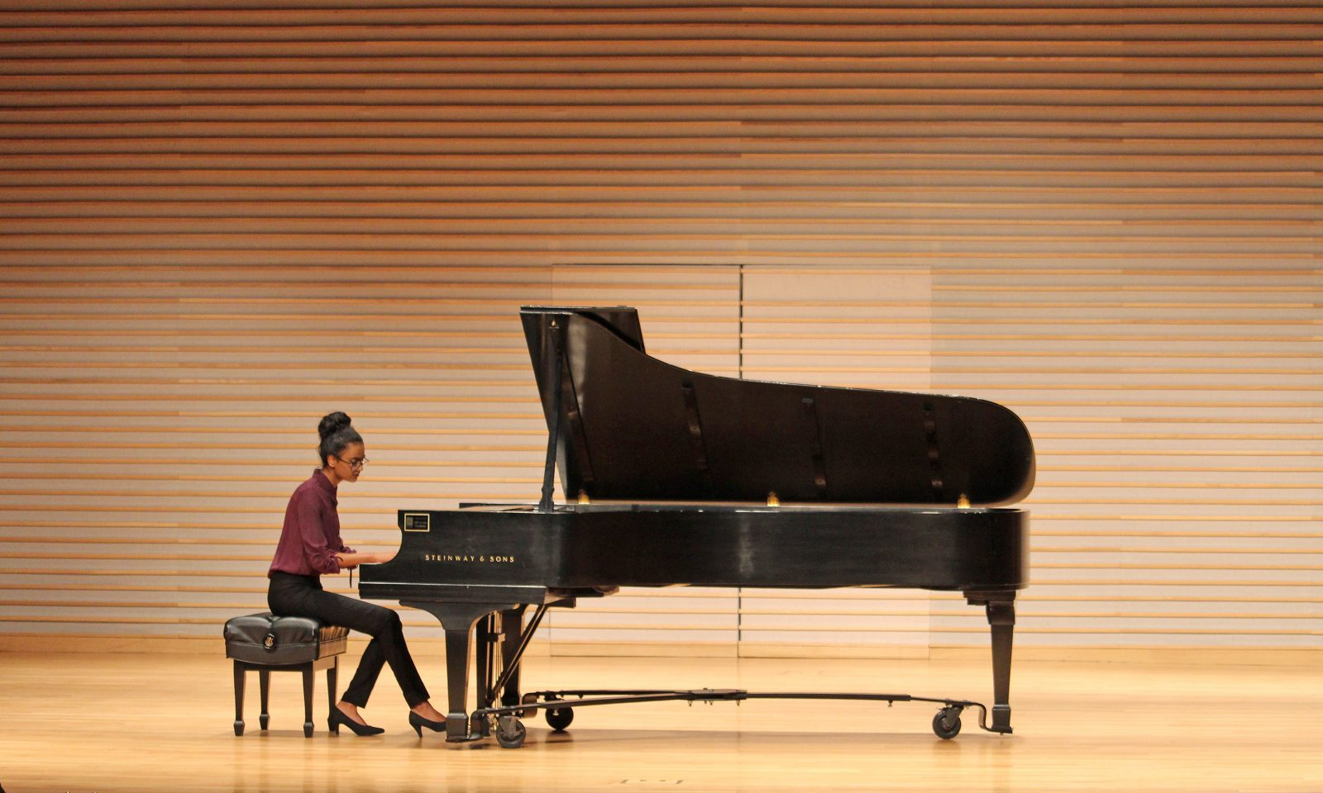
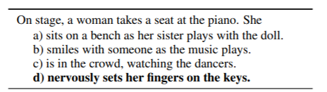
Discussion
Visual supervision helps improve language understanding by endowing pretraining language representation with grounded visual information:
It offers certain connection to from “hollow language symbol” to the physical world from one perspective, therefore making the “meaning” of word more complete.
😕
😕
Visual grounding
😕
😉
An example from SWAG
What are the next?
Incorporating other modalities to comprehensively emulate “meaning” in human minds.
More principled way of combining grounded information from different modalities.

Slide 25
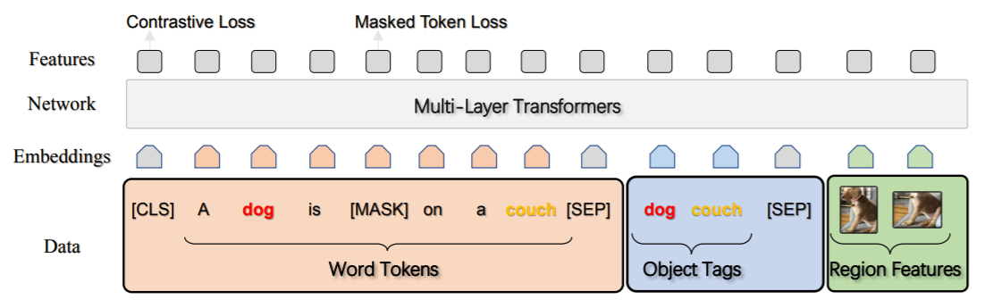
Discussion
VLP models are more effective on multi-modal tasks(e.g., VQA), and generally underperform language-only pretrained models on NLU benchmarks.
Possible reasons:
Statistical discrepancy (e.g., vocab size, sentence length) between grounded language and language in general domain.
The text encoder and vision encoder are usually coupled in VLP models, making the representation power for text diluted, in exchange of better cross-modal semantic alignment.
a) b) OSCAR (ECCV 2020)
What are the next?
Creating larger multi-modal datasets to reduce the discrepancy.
Developing more systematic approach for grounded language representation learning.

Slide 26
Thanks!

